Slide 1

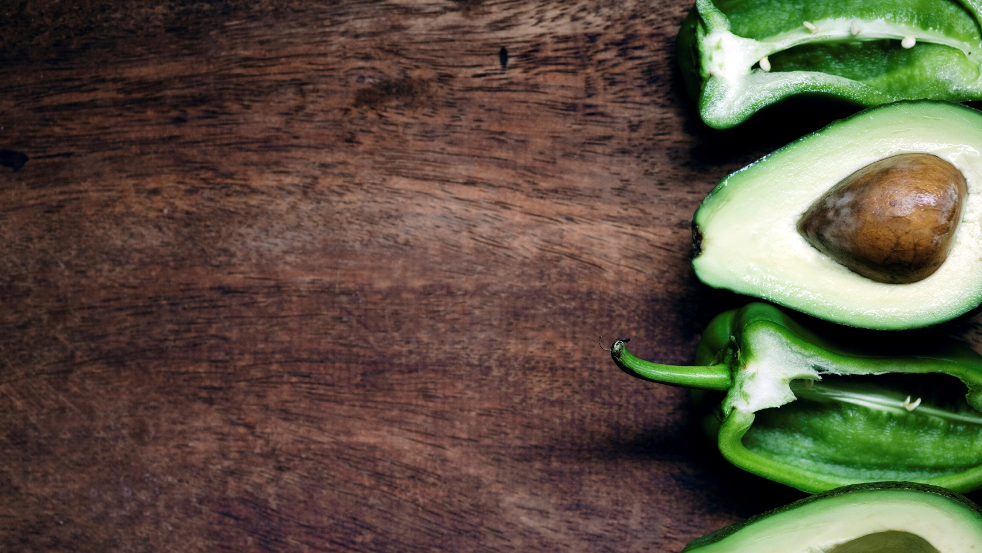
Things to eat, and places to eat them in.
COOKED OR SERVED
A manDown Production

Slide 2
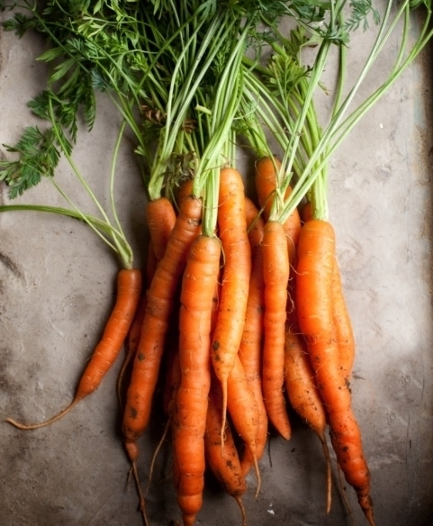
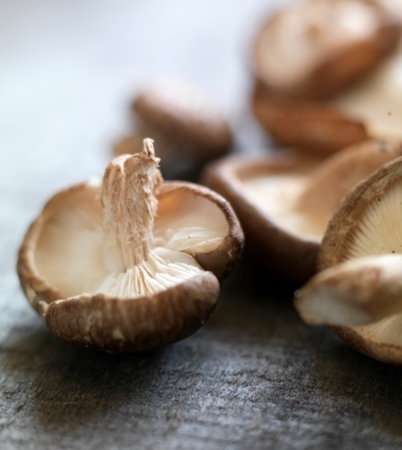

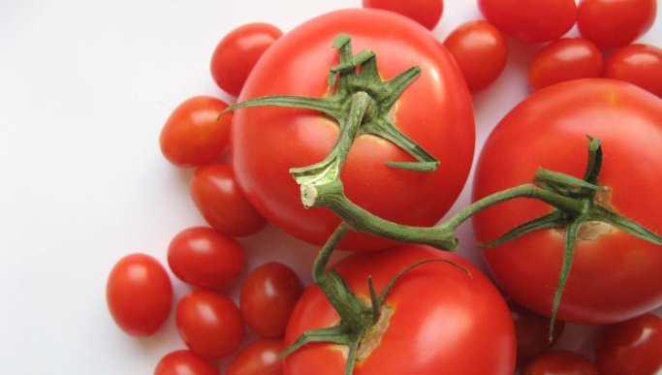

New Technology:
Materialize
Parallax scroll images
Pulse button features
Cleaner edges
Similar grid format
Better all around
Plant
Grow
Pck

Slide 3
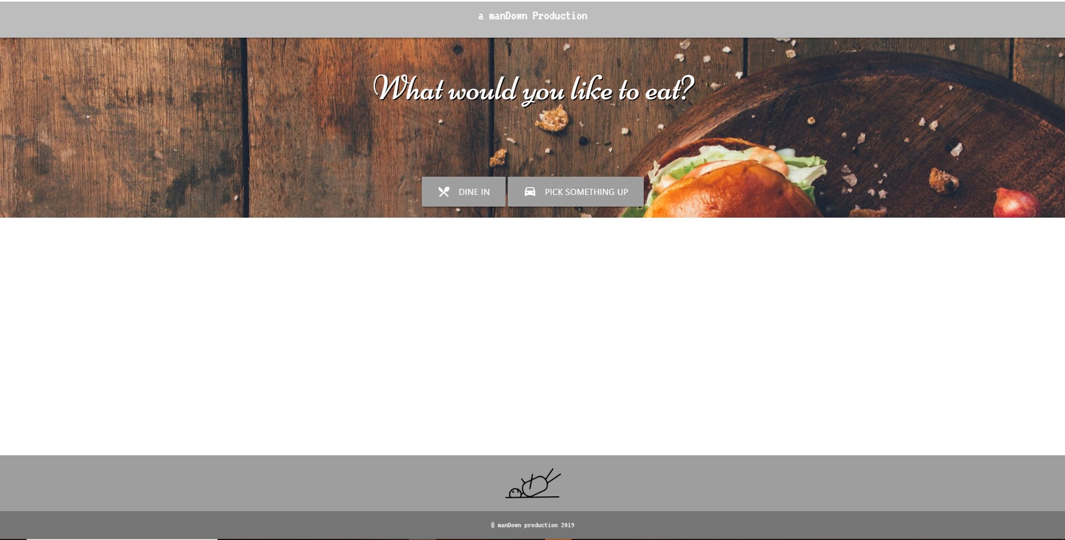
Two APIs Integrated 1) Edamam: Ingredients & Recipes

Slide 4
Two APIs Integrated 2) Zomato: Restaurants & menus Includes reviews with average score Average Costs address link to menu

Slide 5
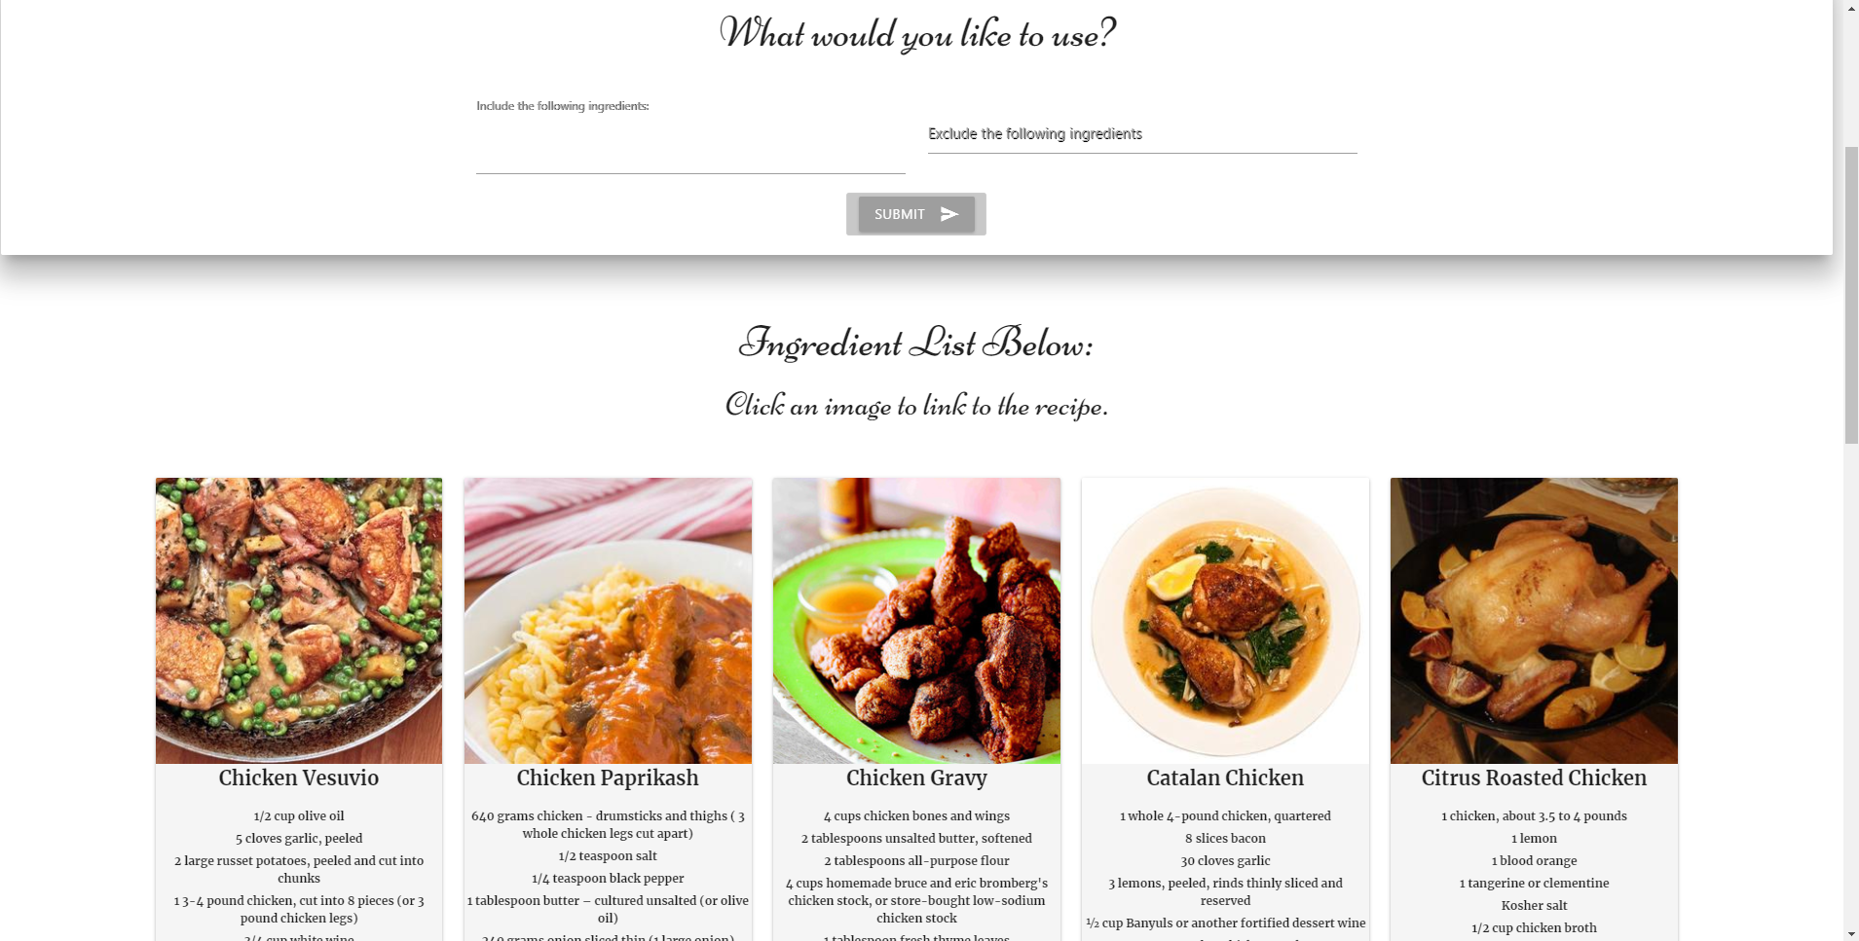
Two APIs Integrated Edamam: Ingredients & Recipes Zomato: Restaurants & menus

Slide 6
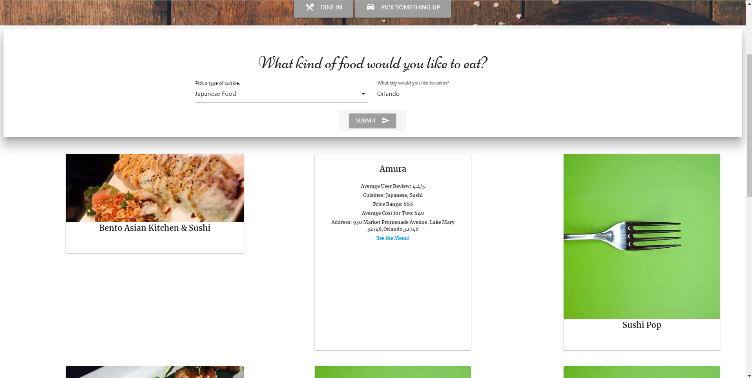
Two APIs Integrated Edamam: Ingredients & Recipes Zomato: Restaurants & menus

Slide 7
Fin.
manDown

